Slide 1

MaaS Demand Responsive Agencies Questions

Slide 2
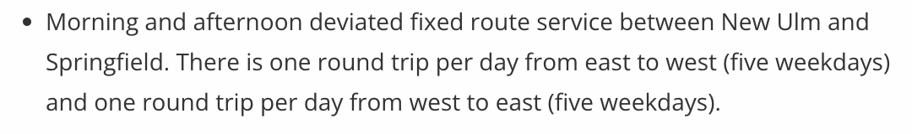
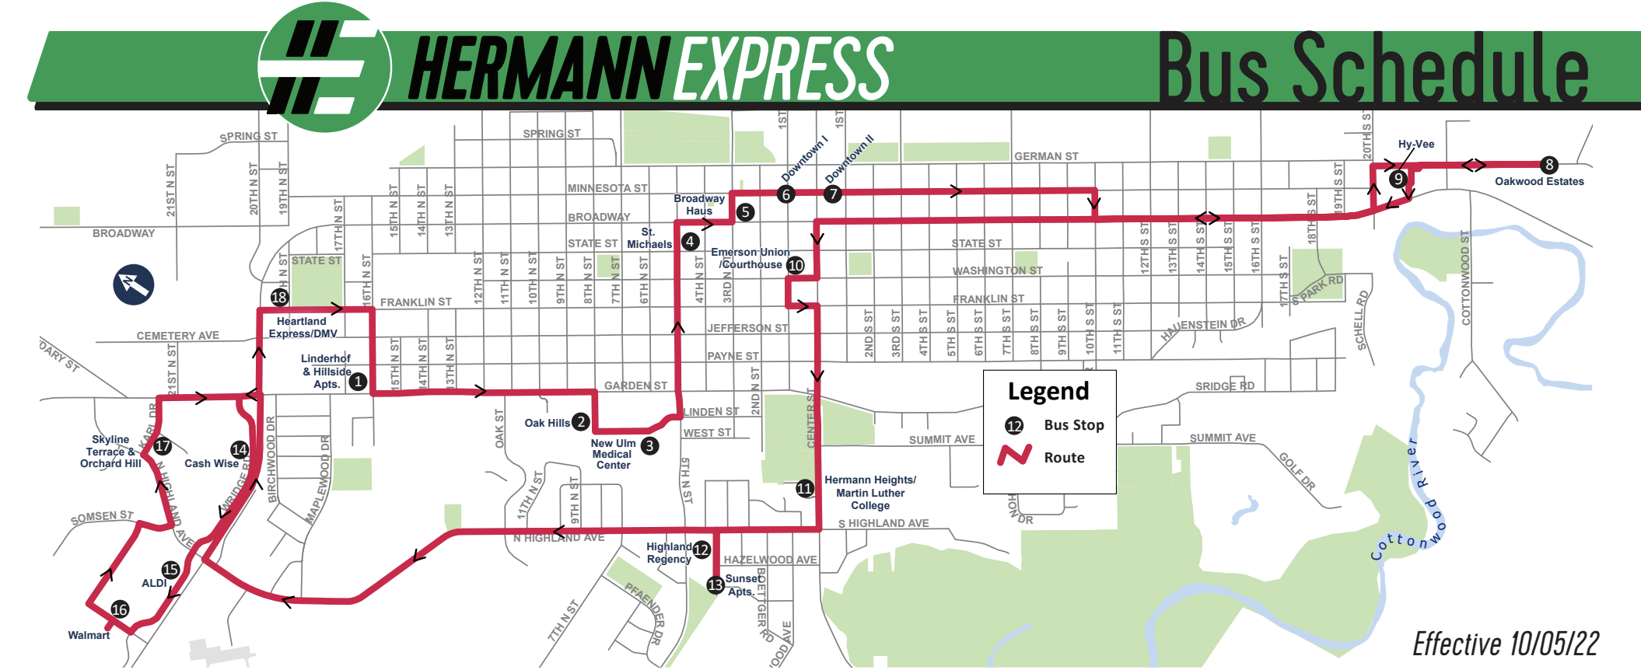
Rural Agencies with Fixed Route Service
Brown County Heartland Express:
New Ulm Hourly Fixed Route
(Route/schedule information not currently available in GTFS – Trillium?)

Slide 3
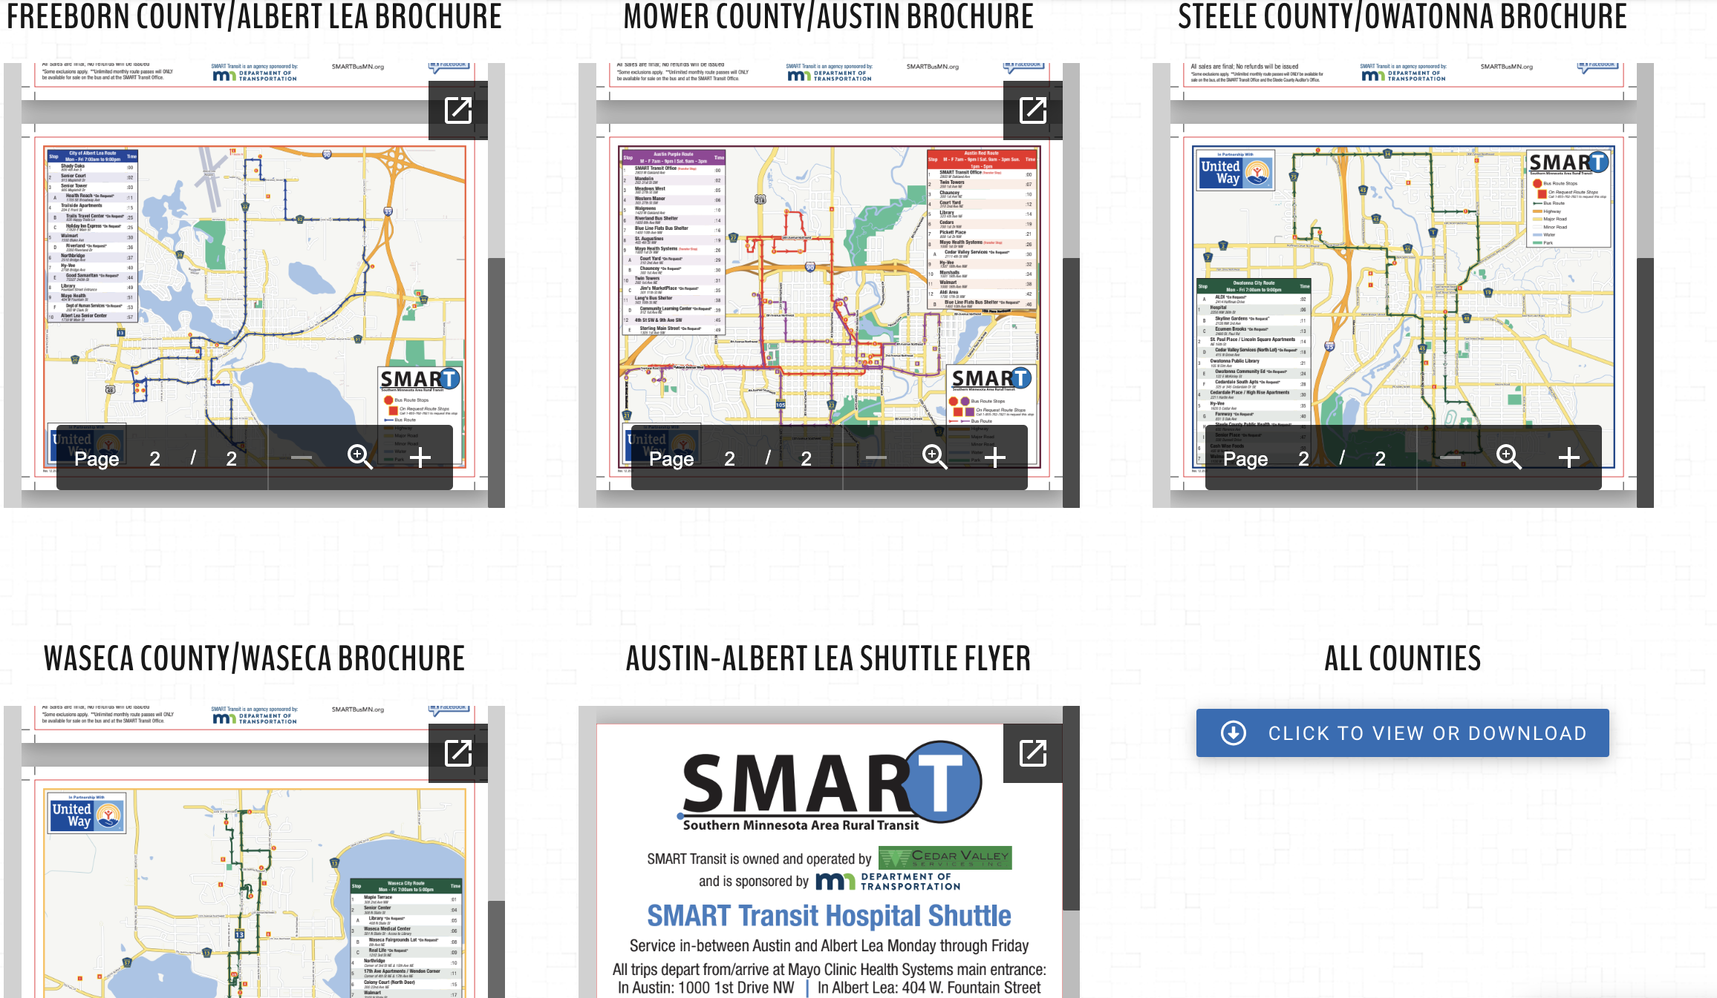
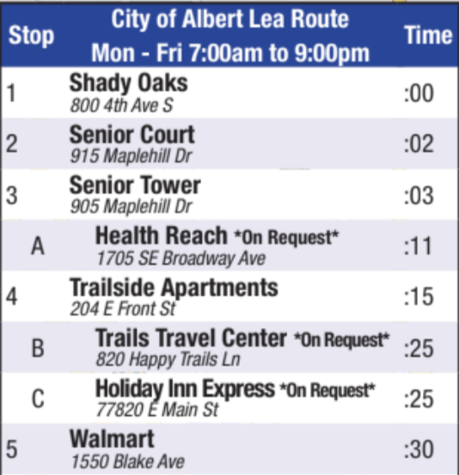
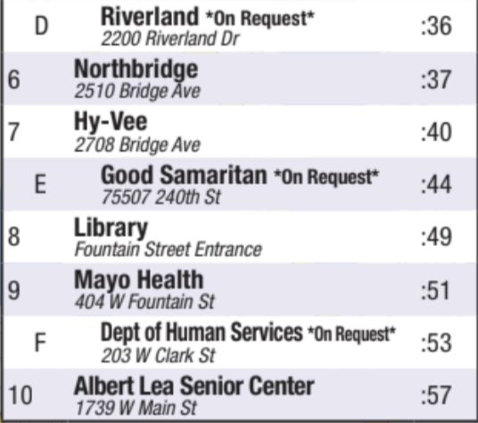
Rural Agencies with Fixed Route Service
SMART Transit- Hourly deviated fixed route services within cities/counties with 3 blocks of deviation allowed for drop-offs. Mostly aimed at giving seniors access to grocery stores, community destinations, health providers
(Route and schedule (not dynamic) available in GTFS)
*Also a fixed route shuttle between Austin and Albert Lea

Slide 4
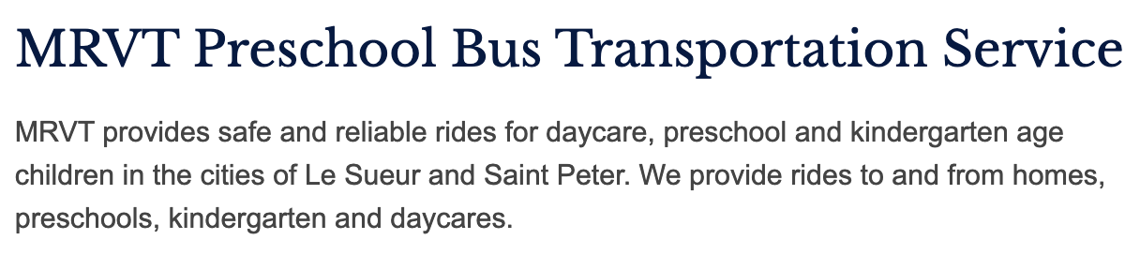
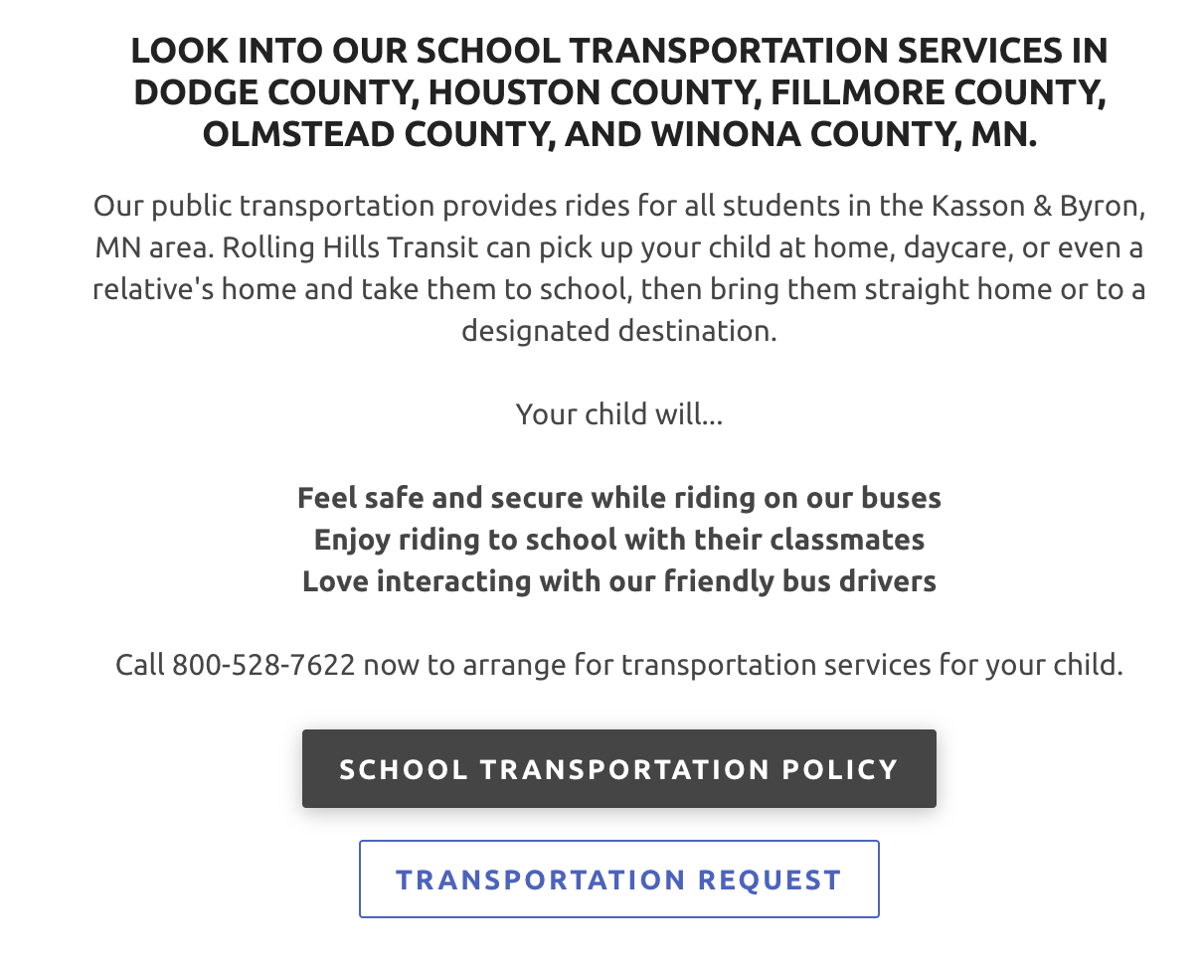
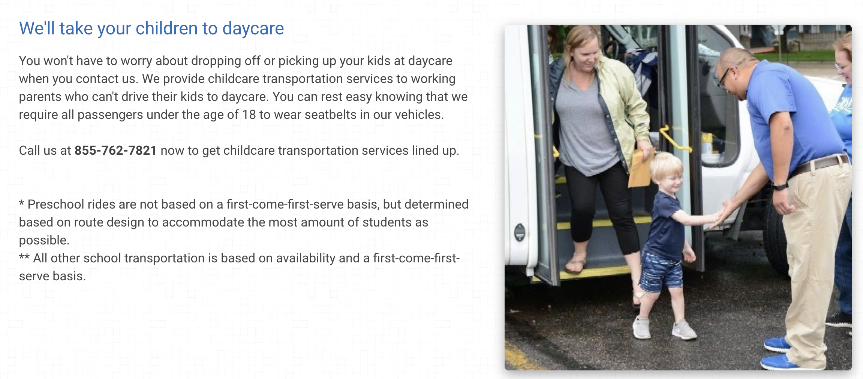
School-Oriented Bus Service – Include?
Minnesota River Valley Transit:
Rolling Hills Transit*:
SMART Transit:
*must register for service before the school year starts

Slide 5
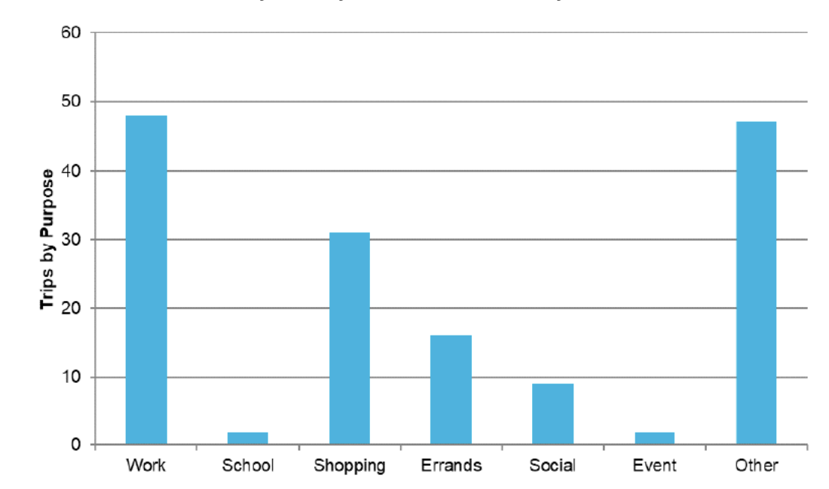
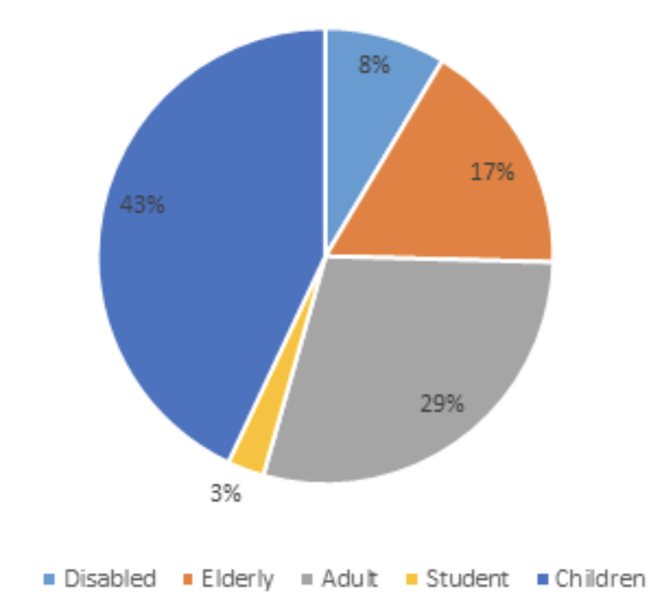
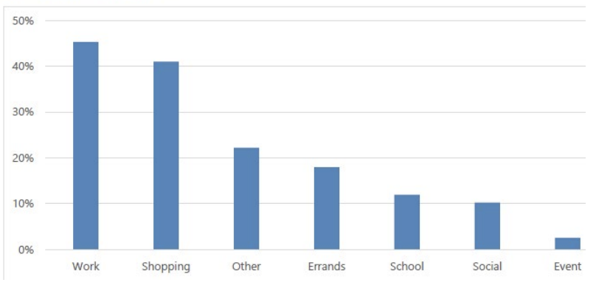
School-Oriented Bus Service – Include?
Rolling Hills Transit 2017 Ridership Breakdown:
Versus Brown County Heartland Express 2016 Trip Purposes:
Versus SMART Transit 2016 Trip Purposes:
[MPTA, 2016-2017 data, 2019 reports]

Slide 6


Clarification: only one rural agency will be able to book trips in the Transit app in Part 2?
CTS Tripmaster is the only scheduling software provider that will integrate trip booking into the app
Rolling Hills Transit is the only rural agency that uses CTS Tripmaster
Should analysis of booking time/decline rate focus only on Rolling Hills Transit?

Slide 7
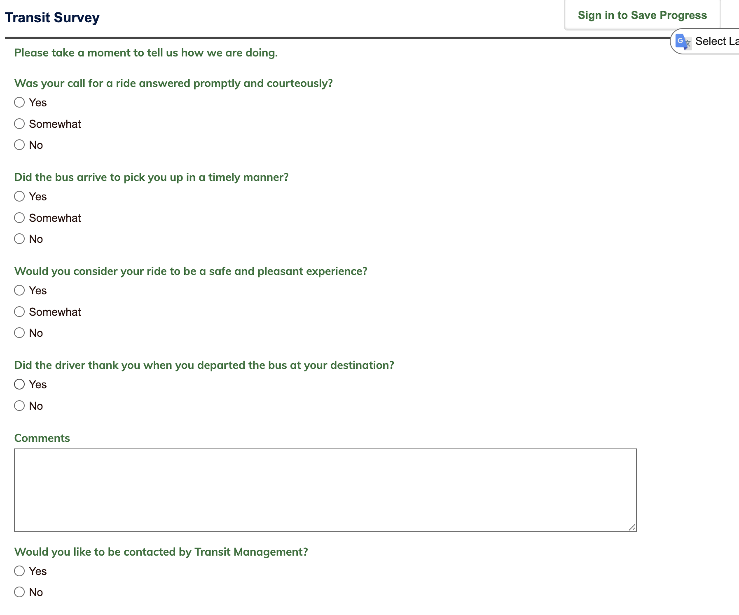
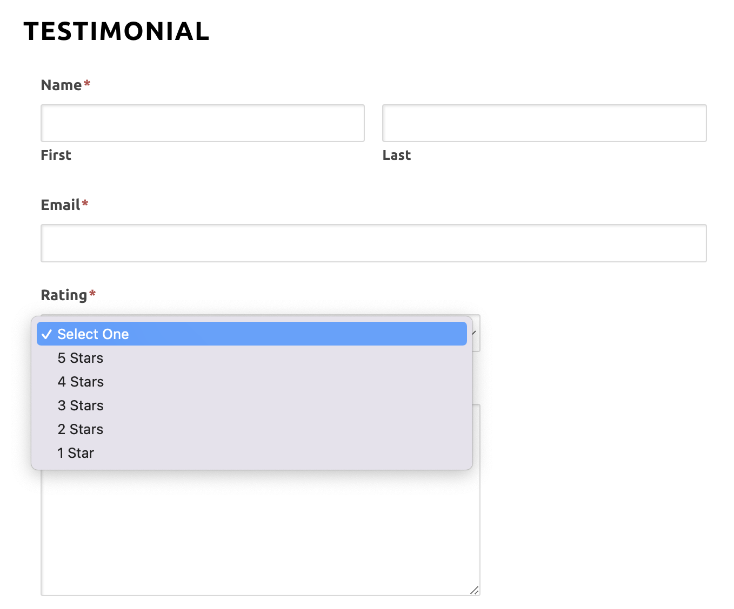
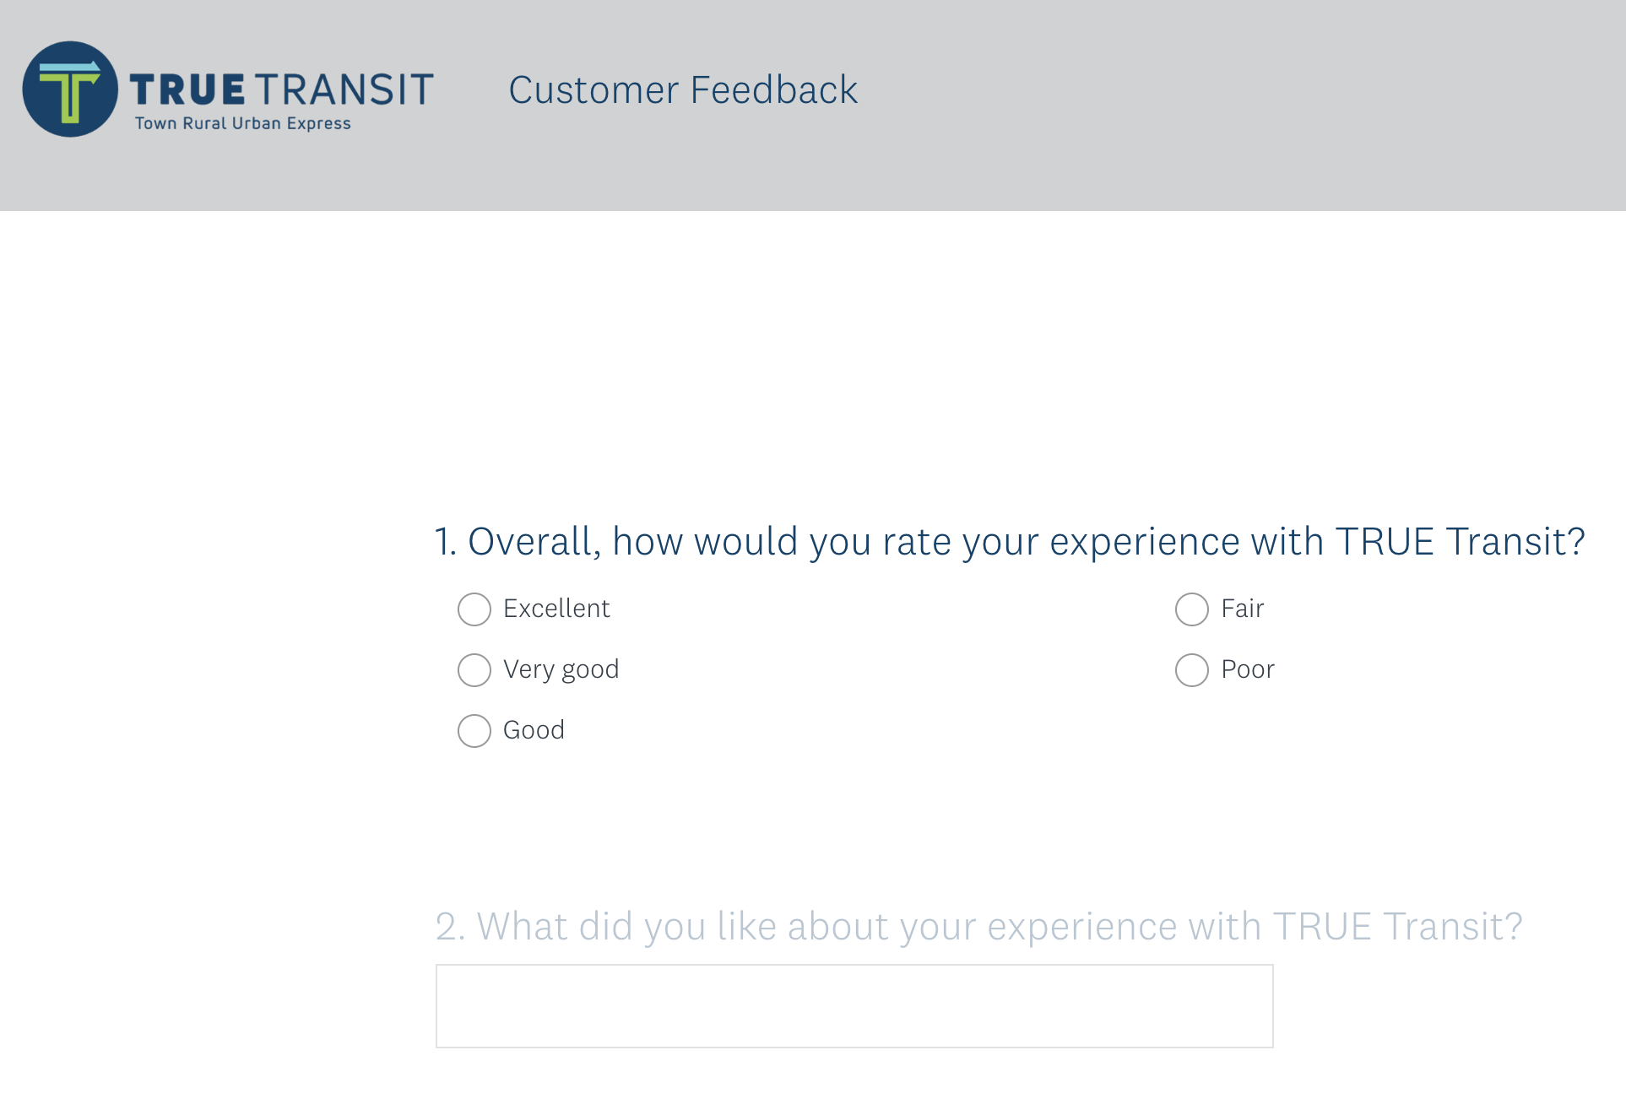
Several Agencies Collect Feedback on Websites
Minnesota River Valley Transit:
Rolling Hills Transit:
TRUE Transit:

Slide 8
What data can we ask rural agencies for?
Ridership reported to MnDOT, is there any detail to it
By route/region?
By time of day?
Any demographic data of ridership/trip purpose split? (ie students, elderly/disabled, etc)
For demand responsive agencies, request they collect data for a month about:
O/D and schedule of trips booked?
Phone call length for booking trips, decline rate? (for Rolling Hills Transit only?)
Should we create an excel sheet/google form/some kind of tool to distribute to the agencies for recording this?

Slide 9
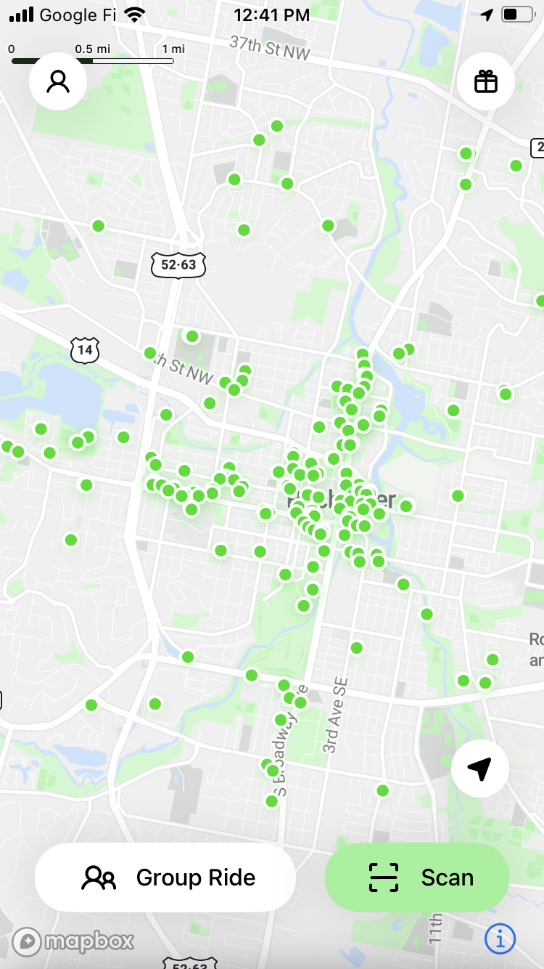
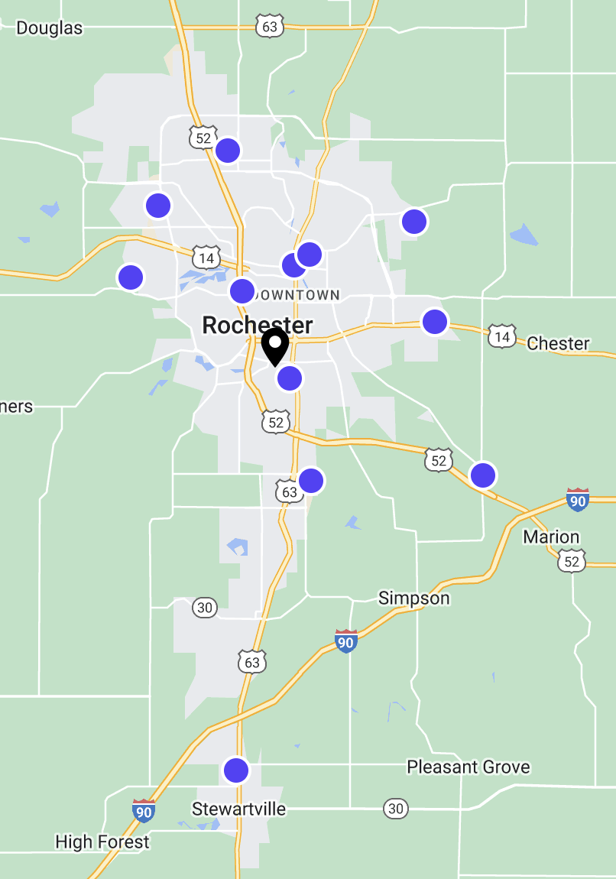
What Micromobility/Shared Mobility will be available?
Lime Scooters/Bikes in Rochester
Turo Car Share Marketplace in Rochester
No other bike shares, e scooters found in study area
Bird in Mankato doesn’t seem to be available in the app
Albert Lea had talked about them?
GBFS exists, but could we get any trip data from the providers? Demographics? Operating cost/revenue?
No centralized car share (Zipcar, Hourcar, etc)
Some Turo car share marketplace availability
With ride-hailing TNCs like Lyft, Uber available on the app, can we coordinate to get data on existing usage/trips taken with those TNCs?
Notes:
Mobility Data Portal

Slide 10
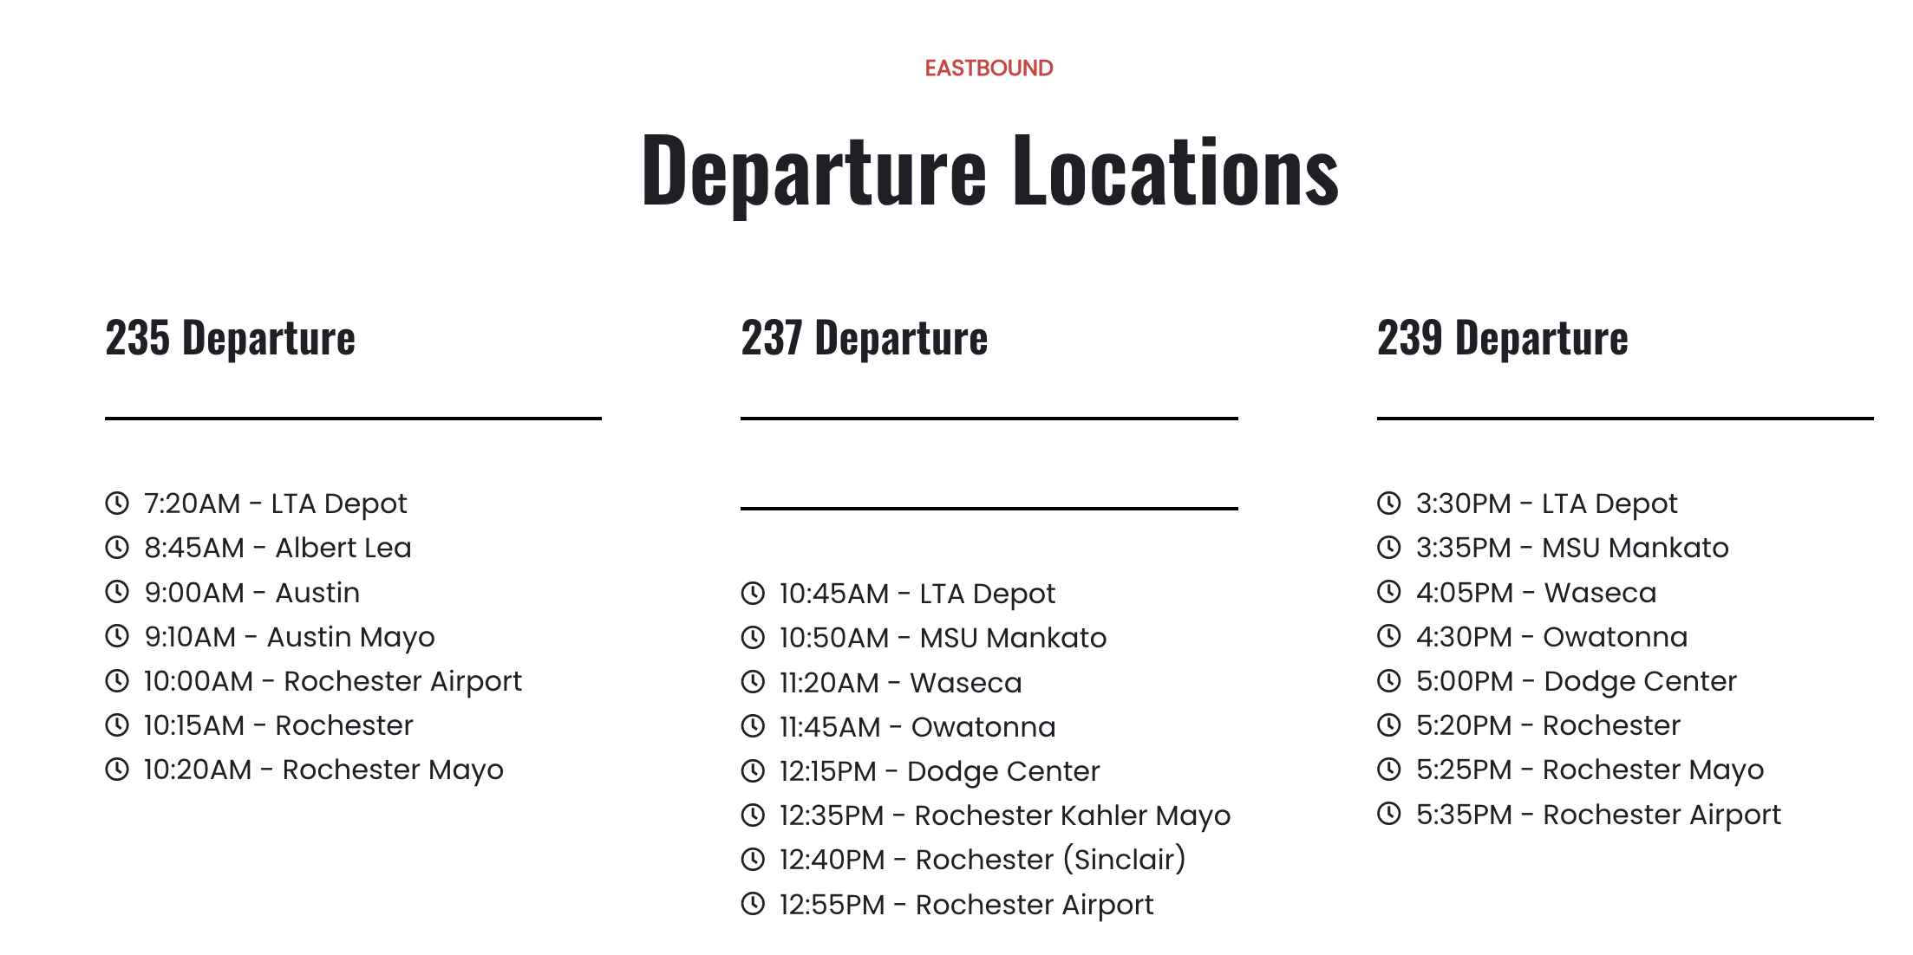
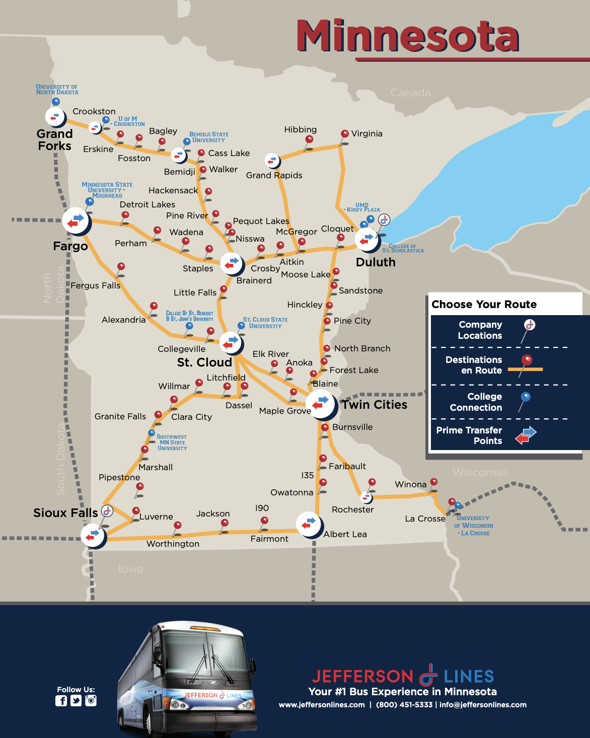
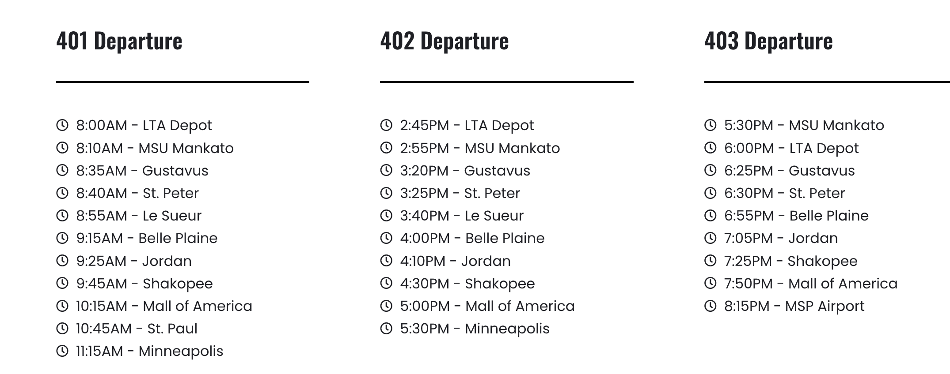
Other Intercity Routes to Consider:
LandAir Express
Jefferson Lines
Ridership data?
Pricing scheme?
O/D trip data?
Revenue and operating cost reports
Will booking be available in transit app?
Can we get average booking time?
Notes:
What was discussed in st cloud?

